Slide 1
PREDICTING LOCATION New Student Residence Pedregalejo, Malaga. Spain
IBM APPLIED DATA SCIENCE CAPSTONE

Slide 2
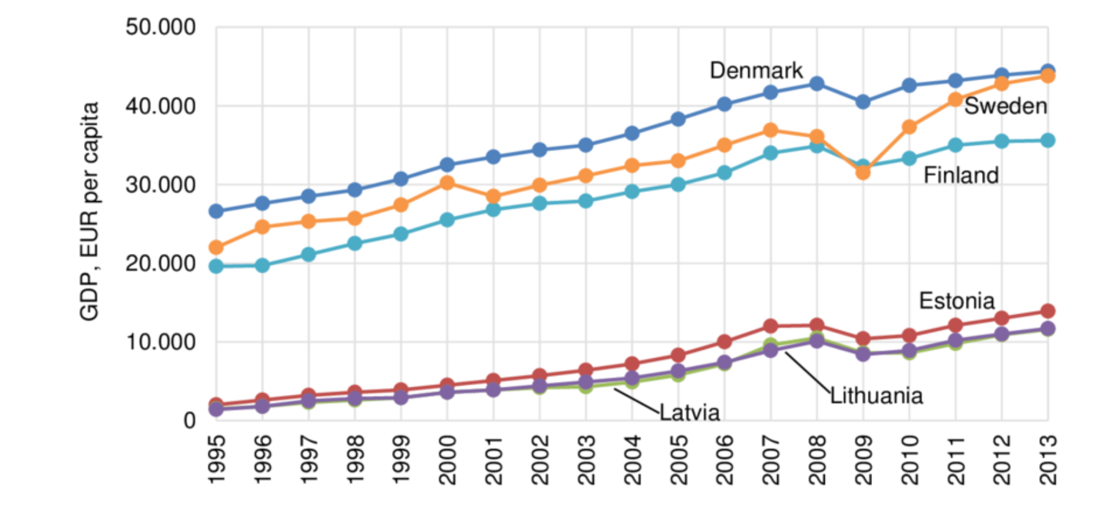
Background
The challenge is to find a suitable location for opening a new Student Residence nearby the beach and language schools where are high variety of restaurants and hotels.
I am from Malaga Spain, specifically from a neighbourhood called Pedregalejo, a beautiful spot for EU Nordic students who come to Malaga to learn Spanish in the cost of Andalusia.
Students would come from wealthy countries such as Norway, Finland, Sweden or Denmark. They are really interested in the Spanish culture and food.

Slide 3
Data Source and How will it be used
We will be completely working on Foursquare data to explore and try to locate our residence where more student residences, Language centres with Spanish courses, beaches, restaurants are present nearby.
We will looking for midpoint area of venues to locate our new hotel. Before that our major focus will be on all venues present in and around the core place of Pedregalejo.
Our core location of Pedregalejo is spotted at 36.7237398,-4.37340

Slide 4
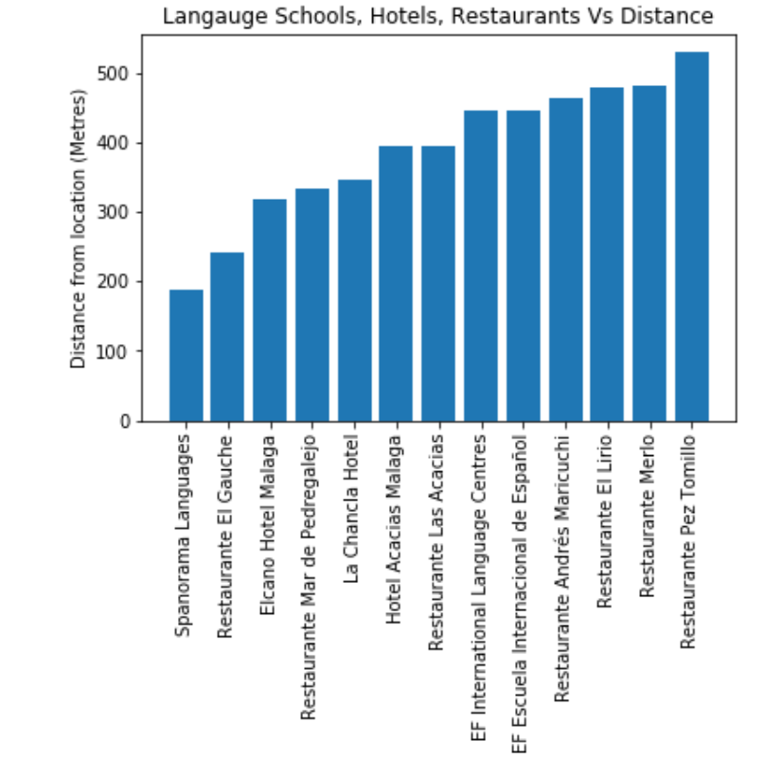
Offer and Competitors
There are 13 hotels, language schools and Restaurants at Pedregalejo within 500 metres radius captured through foursquare data. 
Spanorama Language School is closest Language Centre of core location.
El Gauche is closest Restaurant of core location.
Elcano Hotel Malaga is closest Hotel of core location.
Average distance between all hotels to core location is 390 metres

Slide 5
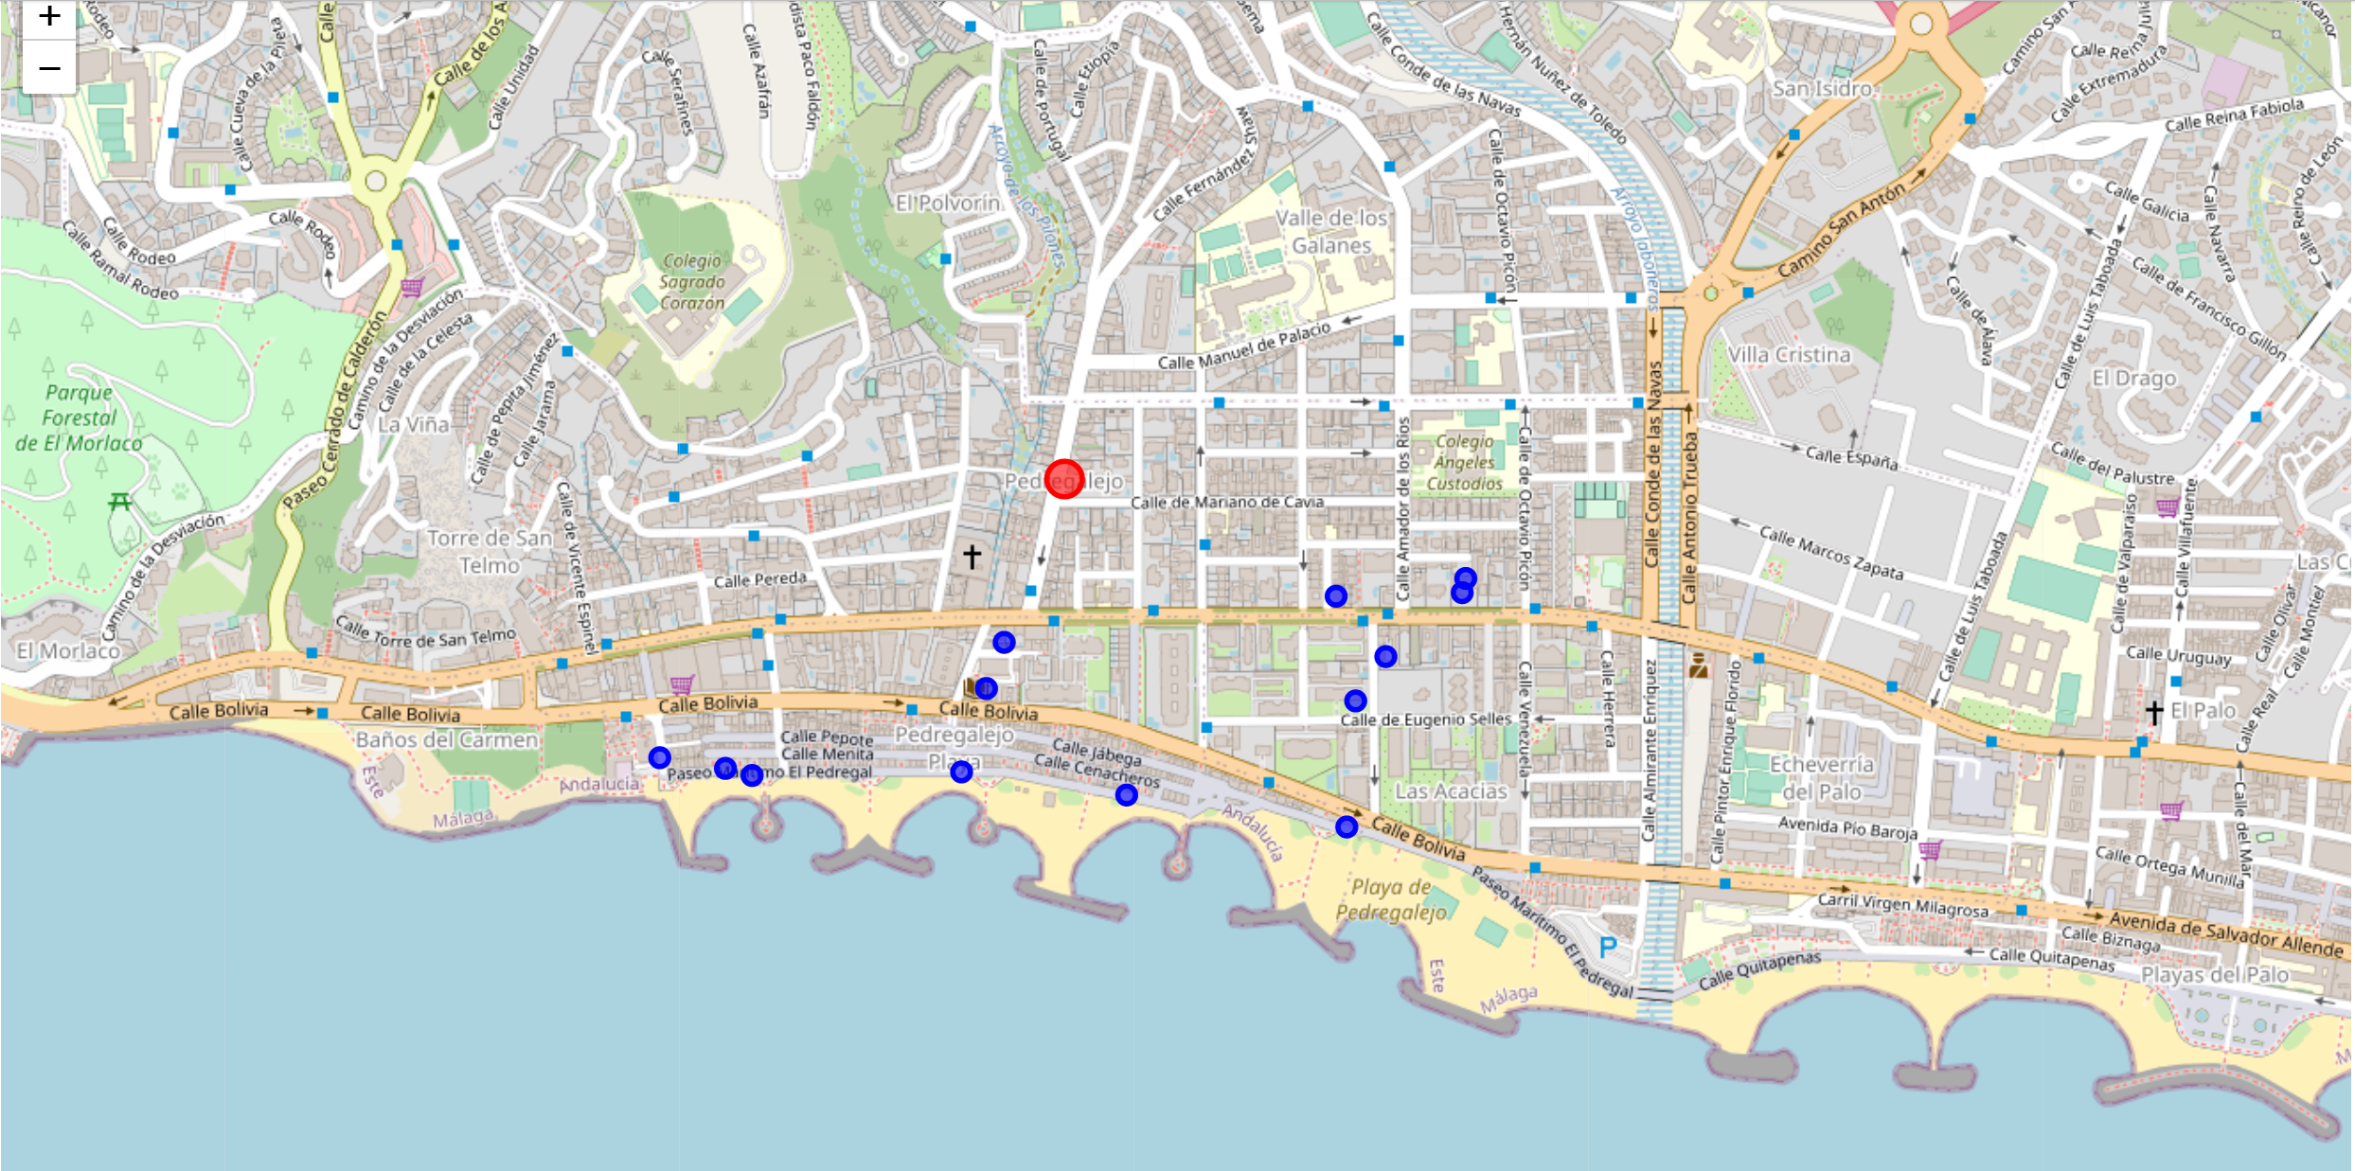
MAP offer and competitors

Slide 6
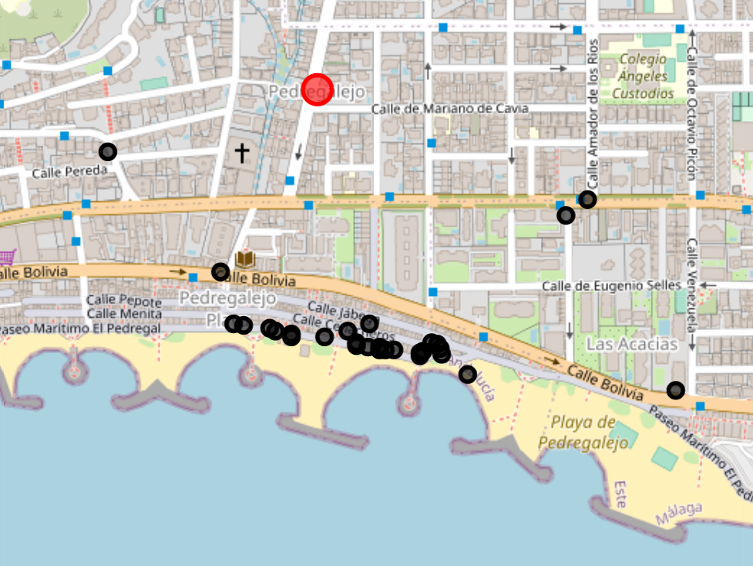
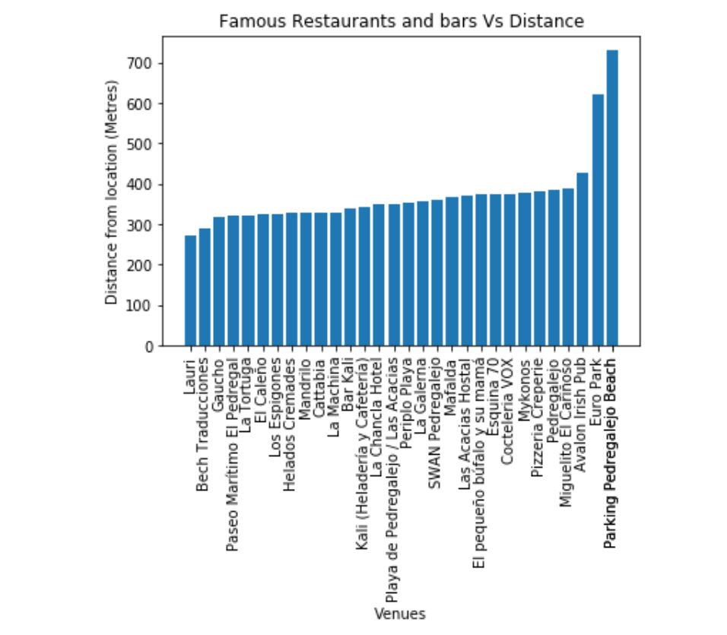
Map – All Restaurants and bars
A Student always wants to visit new venues. So he wants to reside somewhere nearby to all restaurants and bars. We will be exploring more venues around the core location.
There are 31 restaurants & Bars venues within 400 metres radius captured through foursquare data.

Slide 7
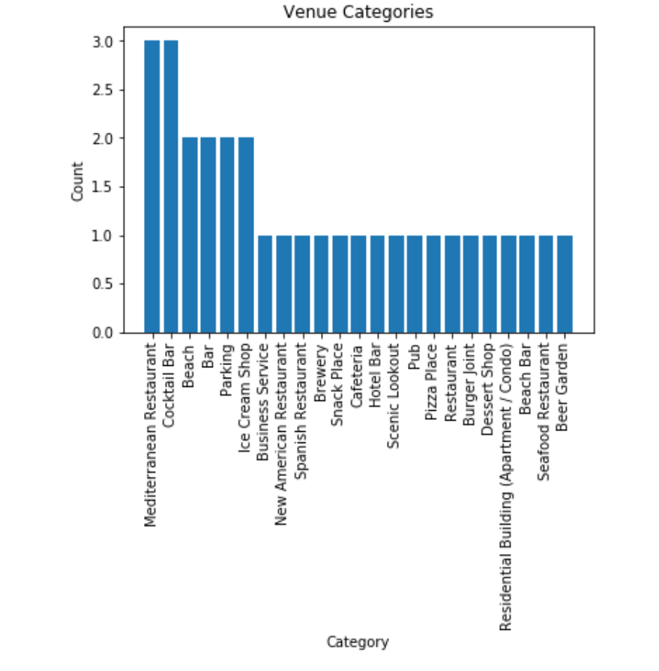
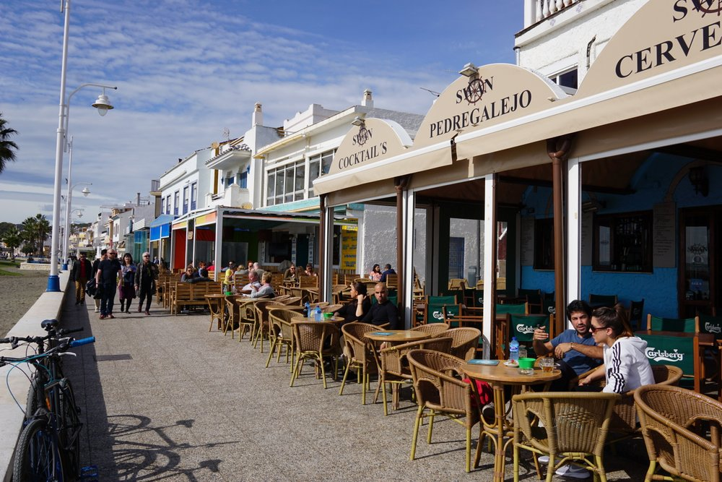
Restaurants and bars categories
There are a high variety within 31 restaurants & Bars and all of them are nearby the core point.
Only a few metres away from the beach!!

Slide 8
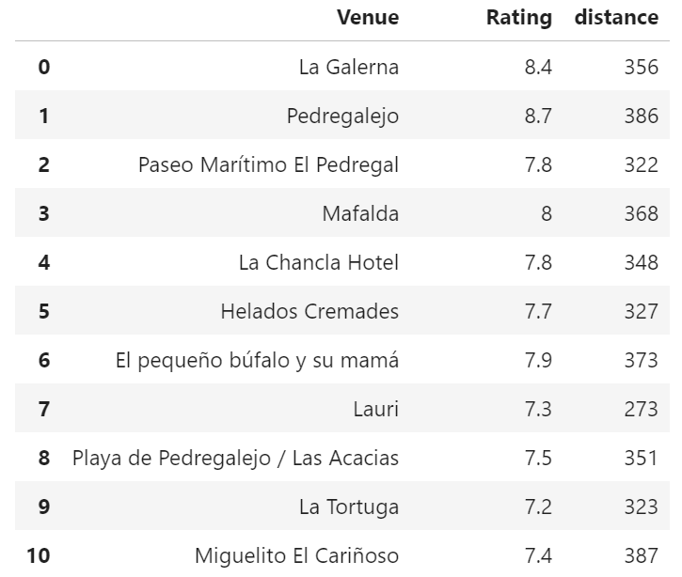
Rating Restaurants and Bars
La Galerna has got highest rating.
Other excellent restaurants and bars are nearby

Slide 9
Clustering and Midpoint of venues
The ideology behind this could be to produce the centre location of all famous top rated restaurants and bars.
First we will find the clusters and based on it, we will take average of all centroids.
Secondly, we will get midpoint of all shortlisted rated restaurant and bars
Now we will get mean of both and decide our final location
We looked for three clusters and they were sorted out as shown in map(next slide)

Slide 10
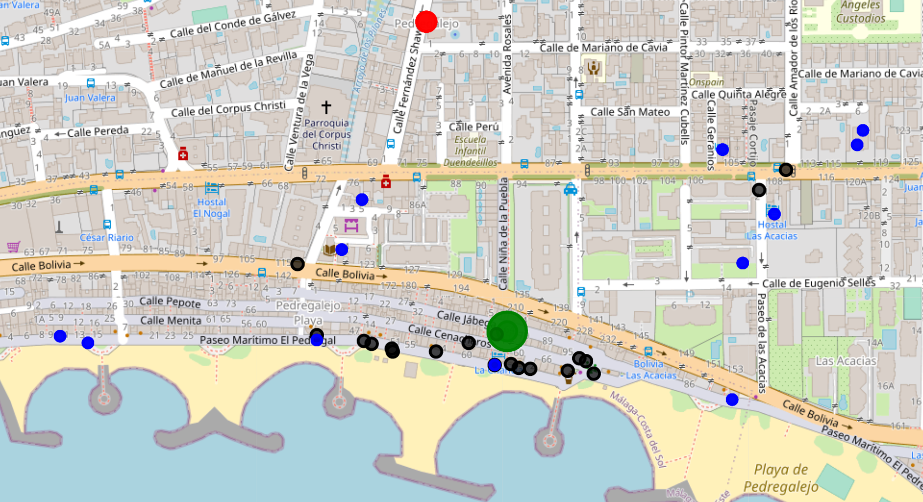
Clustered MAP

Slide 11
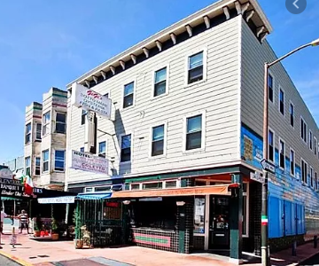
My Predicted Location
Final location is pointed at 36.72097593712997,-4.372508839314111
This location is at Beach Road, surrounded by plenty variety of bars and restaurants. In addition, nearby Language Schools.
Secondly, we will get midpoint of all shortlisted rated venues
Located at exact junction of two cross roads which can give more attention to people who pass both ways.

Slide 12
Discussion & Conclusion
The output which we achieved was very adjacent to the core location. This proves the accurate spotting of our predicted algorithm
As a business person would be able to set up a student residence on given spot, surrounded by excellent bars and hotels together with language schools. This will bring revenue automatically as we have located in very near to core one. We proved this with Kmeans.
Hotel La chancla, ,Hotel Elcano will be our competitors

